Slide 1
Southern Water Corp – Technical Presentation
Date: 05/25/2020
Presenter: Mohit Bansal

Slide 2
Southern Water Corp management wants to control operational costs and prevent untimely asset failure which will lead to loss of revenues
!
To meet increased demand of water supply plants are running harder due to which pump failure events may increase which leads increase in operational cost and ultimately revenue loss.
Problem 1
Increased demand leading to increased pump wear and operational costs
!
Problem 2
Understand what variables may drive an asset failure
Identify a list of variables that may provide an indication of when the pump may be failing
!
Problem 3
Create a multivariate regression
Create an equation that provides a model predictor model and numerical indicator when the Pump is failing

Slide 3
By the multivariate equation it is identified that Pump failure is mostly related with the RPM followed by Flow Meter 2.
Key Insights
R Squared value: Value of Coefficient of determination is 53.65% means 53.65% of movements of pump failure can be explained by given variables.
T-value: Except for Flow Meter 1 all other coefficients are significantly above zero.
Coefficient Values: These are the top three variables affecting Pump
Top 3 Variables
RPM
Flow Meter 2
Max Daily Torque
Source: Southern Water Corp Statistical Records

Slide 4
Problem Statement and Solution Approach
Southern Water Corp is running his plants harder to meet increasing water demand. One of the chief scientists, noted particular signatures around a number of pumps that had provided abnormally high-pressure readings, indicative of system failure. To control operational costs and prevent untimely asset failure, management wants to do a statistical analysis of previous Desalination Pump Failure Data to understand what variables may drive an asset failure.
STATISTICAL APPROACH #1
Descriptive Analysis
STATISTICAL APPROACH #2
Inferential Analysis

Slide 5
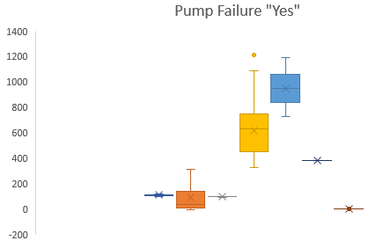
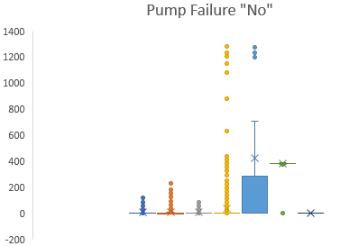
Pump Failure with “No” flag has lot of outliers specially for Torque, Flow Meter2, RPM. Mean of flow_meter1 for Pre failure is 5 and for Post failure is 110.Table at bottom shows Mean, Median and Mode for Pre-failure and Post-failure values of all variables which can derive pump failure.
 | FLOW_METER_1 | FLOW_METER_2 | PUMP_RPM | PUMP_TORQUE | DAILY_PUMP_TORQUE | TUBE_PRESSURE | EFFICIENCY
Pump Failure Yes - Mean | 109.79 | 87.64 | 96.45 | 619.69 | 952.51 | 381.40 | 0.86
Pump Failure No - Mean | 4.97 | 4.39 | 5.77 | 33.65 | 422.43 | 380.69 | 0.64
Pump Failure Yes - Median | 109.95 | 37.88 | 99.00 | 629.37 | 949.39 | 381.35 | 0.86
Pump Failure No - Median | 0.31 | -0.40 | -0.02 | -1.90 | 285.49 | 381.32 | 0.18
Pump Failure Yes - Mode | N/A | N/A | 99.00 | N/A | N/A | N/A | N/A
Pump Failure No - Mode | 0.00 | -9.01 | 0.00 | 0.00 | 285.49 | 382.69 | 0.00

Slide 6
Correlation Matrix for Rolling Standard Deviation : Post Failure correlation matrix shows more correlations as negative in comparison to Pre Failure
Post Failure Correlation | FLOW_METER_1 | FLOW_METER_2 | ROTATIONAL_PUMP_RPM | PUMP_TORQUE | MAXIMUM_PUMP_TORQUE | TUBE_PRESSURE
FLOW_METER_1 | 1.00
FLOW_METER_2 | 0.04 | 1.00
ROTATIONAL_PUMP_RPM | 0.89 | 0.03 | 1.00
PUMP_TORQUE | -0.27 | -0.80 | -0.31 | 1.00
MAXIMUM_PUMP_TORQUE | -1.00 | -0.04 | -0.89 | 0.27 | 1.00
TUBE_PRESSURE | 0.63 | 0.04 | 0.23 | -0.07 | -0.65 | 1.00
ESTIMATED_EFFICIENCY | 0.21 | 0.10 | 0.43 | -0.46 | -0.20 | -0.31
Pre Failure Correlation | FLOW_METER_1 | FLOW_METER_2 | ROTATIONAL_PUMP_RPM | PUMP_TORQUE | MAXIMUM_PUMP_TORQUE | TUBE_PRESSURE
FLOW_METER_1 | 1.00
FLOW_METER_2 | 0.67 | 1.00
ROTATIONAL_PUMP_RPM | 0.71 | 0.61 | 1.00
PUMP_TORQUE | 0.76 | 0.51 | 0.69 | 1.00
MAXIMUM_PUMP_TORQUE | 0.00 | 0.16 | -0.07 | -0.01 | 1.00
TUBE_PRESSURE | 0.05 | 0.06 | 0.06 | 0.05 | 0.16 | 1.00
ESTIMATED_EFFICIENCY | 0.12 | 0.03 | 0.04 | 0.10 | 0.12 | 0.11
Key Insights
Positive Correlations:
For Post Failure: There is only one strong correlation between “Flow Meter 1 and Pump RPM”.
For Pre Failure: There are majorly positive correlation out of which “Flow Meter 1 and Pump RPM” and “Flow Meter 1 and Pump Torque” are having very strong positive correlation.
Negative Correlations:
For Post Failure: We observer three strong negative correlations: “Flow Meter 1 and Max Daily Torque”, “Flow Meter 2 and Torque” and “RPM and Max Daily Torque”
For Post Failure: We observer only two very weak negative correlations: “Torque and Max Daily Torque” and “RPM and Max Daily Torque”

Slide 7
Summary: Top and Bottom “3”
Most Important* Variables:
Out of 8 variables, 3 variables: RPM, Torque and Flow Meter 2 should be closely observed, as in our analysis we found lot of variation between Pre and Post Failure Readings.
Most Insignificant* Variables:
Out of 8 variables, 3 variables: Tube Pressure, Estimated Efficiency, Ammonia Flow Rate can be neglected when we need to estimate pump failure as they have negligible correlation between them.
* Only in terms of Pump Failure. For other factors they must be important readings.

